Slide 1
Final Project Report for CS50X Course – Introduction to Computer Science Multi Apps Software On Java Programming language

Slide 2
Details about me
Projects Title- Multi Apps Software On Java Programming language
Name – Sana Maqsood Khan
City – Bhopal
Country – India
Profession – Software Programmer and a Programming Trainer.

Slide 3
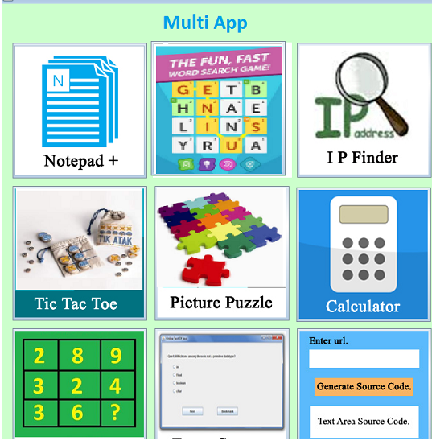

Slide 4
Screen shots of a project

Slide 5
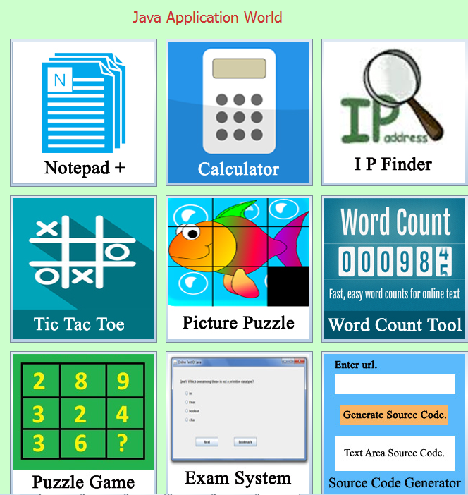

Slide 6
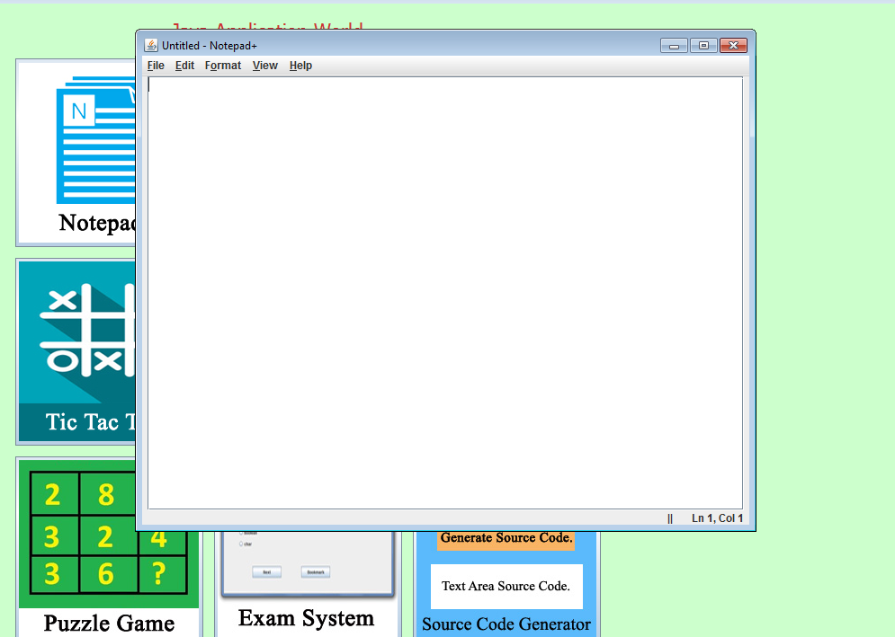

Slide 7
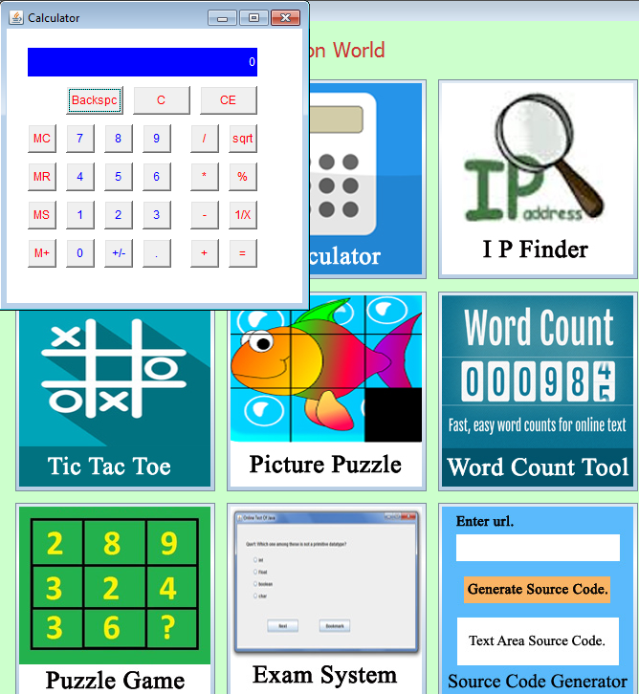

Slide 8
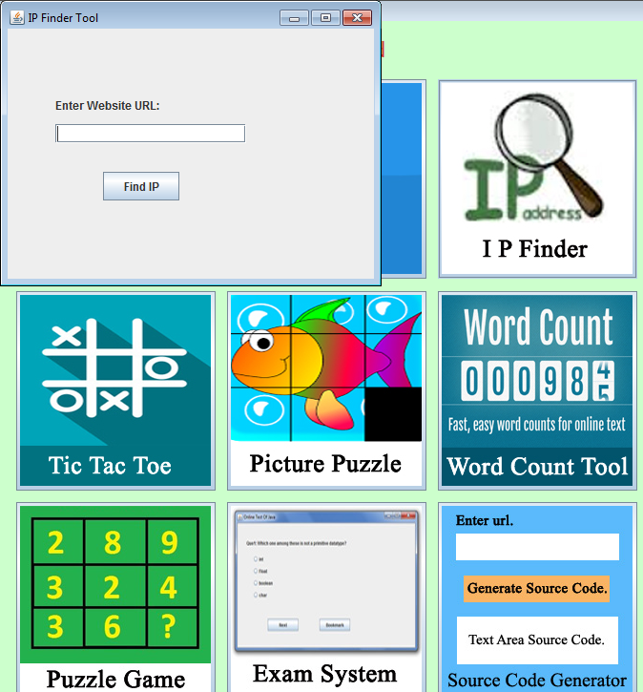

Slide 9
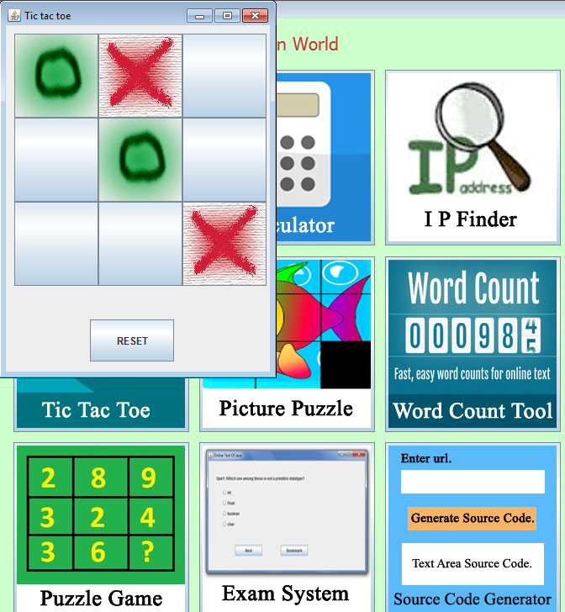

Slide 10
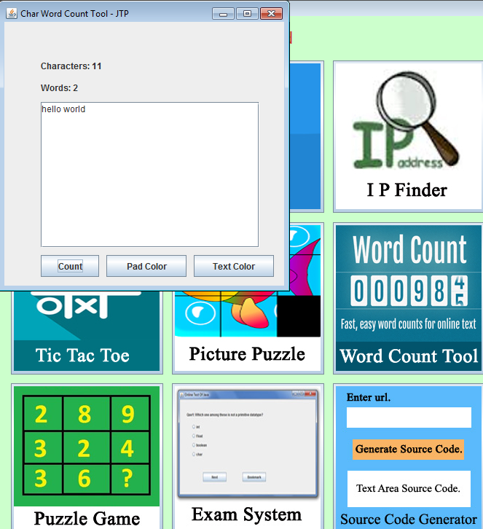

Slide 11
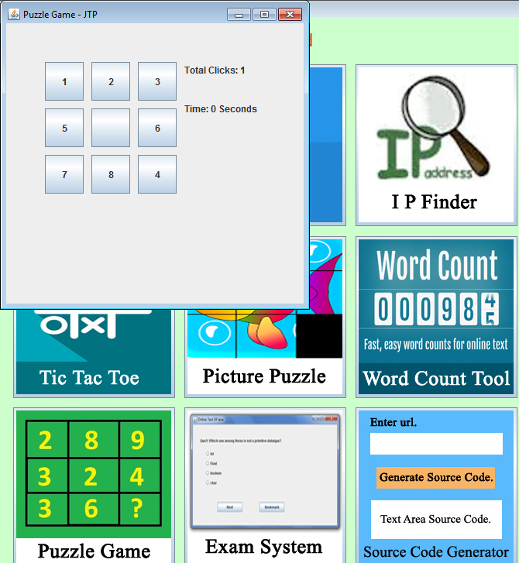

Slide 12
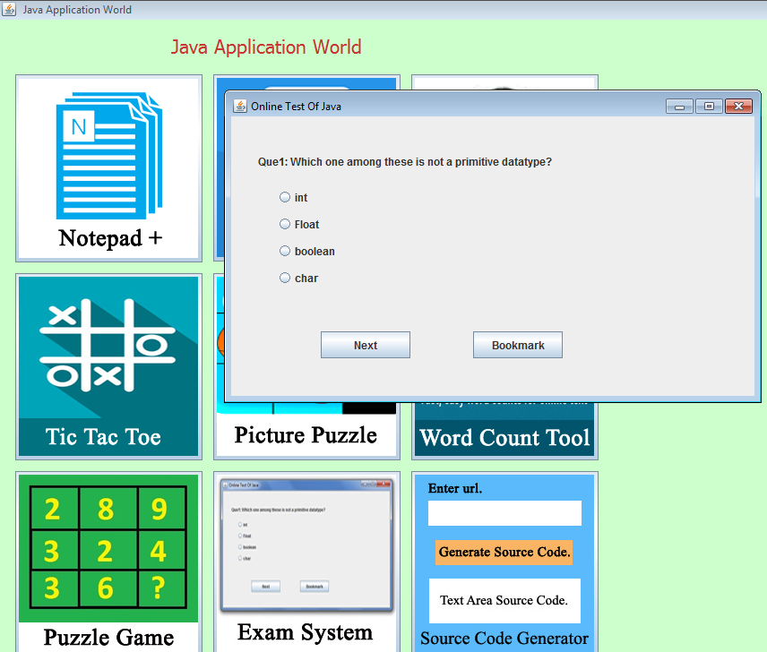

Slide 13
